Slide 1
بِسْمِ ٱللَّهِ ٱلرَّحْمَٰنِ ٱلرَّحِيمِ

Slide 2
Course: Web Designing
Institute: Corvit Systems Peshawar
Duration: 3-Month Web Designing & Development Course
4th class of JS (Java script)
Topic : DOM manipulation

Slide 3
Instructor: Muhammad Sahil
BS in Computer Science – University of Peshawar
1 Year MERN Stack Developer – E Digital Pakistan (KPITB)
1 Year Web Instructor – E Digital Pakistan
6 Months Web Instructor – University of Peshawar
Computer Science Teacher – Alflah Model College, Sarband
Experience with multiple local client projects
Full Stack / MERN Stack Web Developer | Web Instructor

Slide 4
What is DOM?
DOM stands for Document Object Model.
DOM allows JavaScript to:
Access HTML elements
Change text and styles
Add or remove elements
Respond to user actions
DOM connects HTML + JavaScript.

Slide 5
Selecting HTML Elements
JavaScript selects HTML elements to work with them.
Common methods:
getElementById();
querySelector();
After selection, elements can be modified using JavaScript.

Slide 6
Changing Text & Styles
Using DOM, JavaScript can:
Change text content
Change colors
Change font size and style
This is commonly used in:
Buttons
Notifications
Interactive UI

Slide 7
Creating & Removing Elements
JavaScript can dynamically:
Create new HTML elements
Add them to the page
Remove existing elements
Used in:
To-Do apps
Lists
Dashboards
etc

Slide 8
Form Handling with JavaScript
JavaScript handles forms by:
Preventing page reload
Reading user input
Validating input
Showing messages
Used in login, signup, and contact forms.

Slide 9
Code example Screen shots from next slide

Slide 10
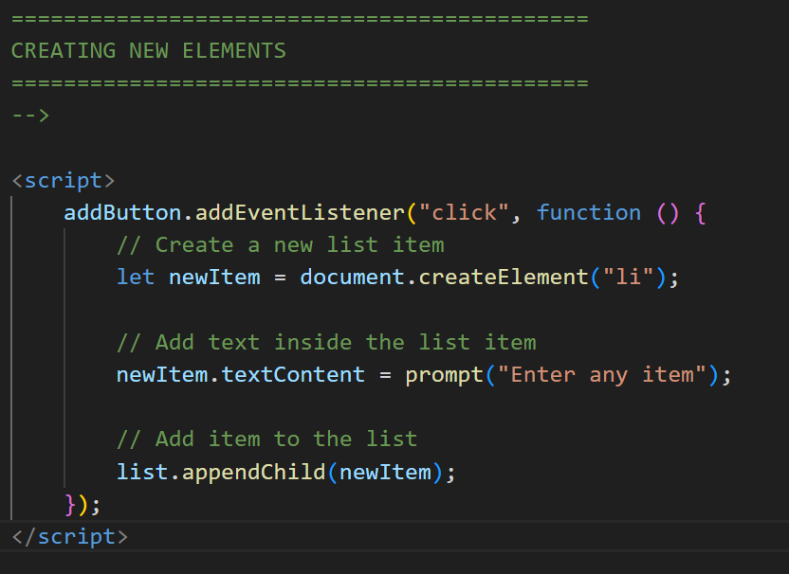
document.createElement( );
parentName.appendChild( ) ;

Slide 11
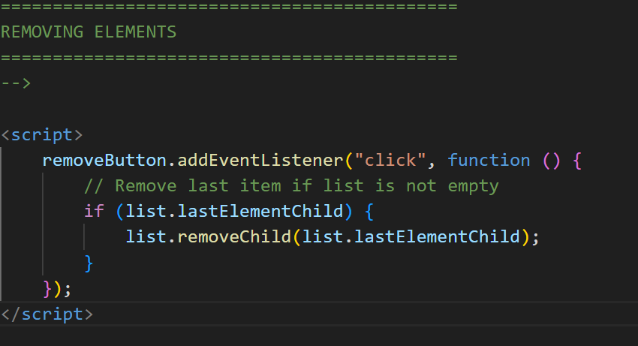
removeChild( );

Slide 12
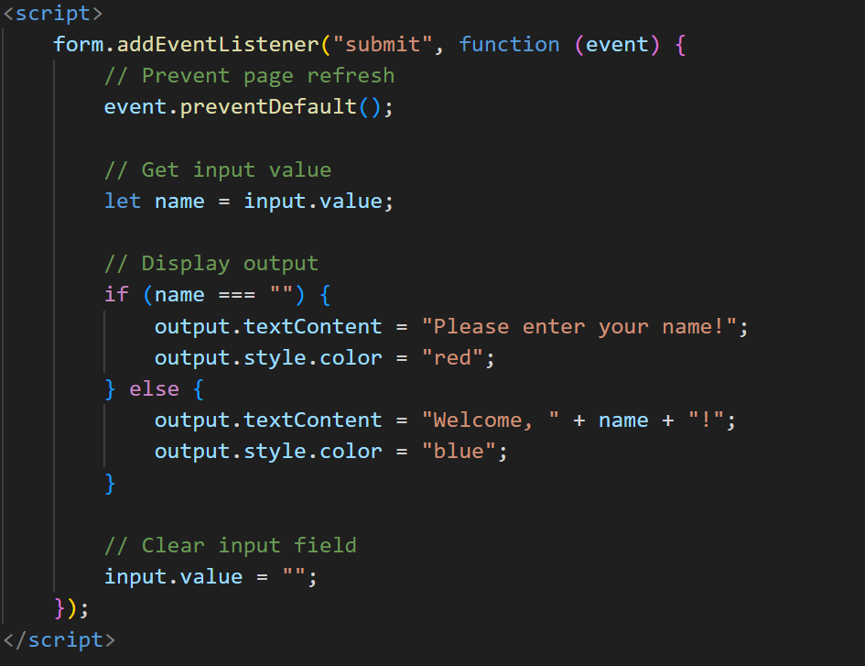
Form handling

Slide 13
Mini Project & Summary
Mini Project:
Add items
Remove items
Handle form input
Today you learned:
DOM basics
Selecting elements
Changing content

